Slide 1


Team EarlyBirds: HR Attrition Prediction System
Sairaj Dixit Yogananda Gone Nikshita Burde
Abhijit Joshi Avdhut Kulkarni
Confidential © 2022 Persistent Systems

Slide 2

OUTLINE
Problem Statement
Objective and Scope of the project
Data Sources
Functionality & Block Diagram
Architecture Diagram
Work Flow & Analytics Approach
Business Values
Architecture & Working Model
Integration
Prediction and Result
Future Updations
Q & A
Confidential © 2022 Persistent Systems

Slide 3
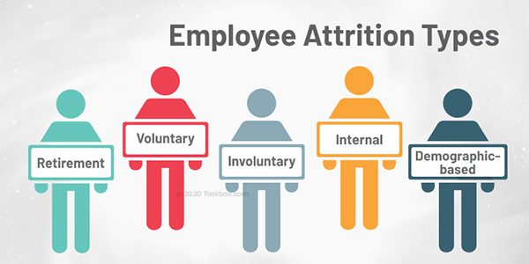
PROBLEM STATEMENT
The Great Resignation phenomenon of 2021 is causing high attrition of unplanned nature. It is a very challenging and costly affair to replace the employees who leave in an unplanned manner. Such high-risk employees, if identified in advance allow the organization time to plan and even take corrective actions to retain them.
Additional information – IBM HR Attrition Dataset: https://www.kaggle.com/anupjana/ibm-hr-employee-attrition-analysis-prediction
Confidential © 2022 Persistent Systems

Slide 4

OBJECTIVE AND SCOPE OF THE PROJECT
The objective of this project is to predict the attrition rate for each employee, to find out who's more likely to leave the organization.
It will help organizations to find ways to prevent attrition or to plan in advance the hiring of new candidate.
Attrition proves to be a costly and time consuming problem for the organization and it also leads to loss of productivity.
The scope of the project extends to companies in all industries.
Confidential © 2022 Persistent Systems

Slide 5
DATA SOURCES
For this project, an HR dataset named 'IBM HR Analytics Employee Attrition & Performance', has been picked, which is available on IBM website.
The data contains records of 1,470 employees.
It has information about employee's current employment status, the total number of companies worked for in the past, Total number of years at the current company and the current roles, Their education level, distance from home, monthly income, etc.
Confidential © 2022 Persistent Systems

Slide 6
FUNCTIONALITY & BLOCK DIAGRAM
Data Cleaning
Data Acquisition
Model Training
Model Evaluation
Deployment
Attrition Prediction
Performance Evaluation
Confidential © 2022 Persistent Systems

Slide 7
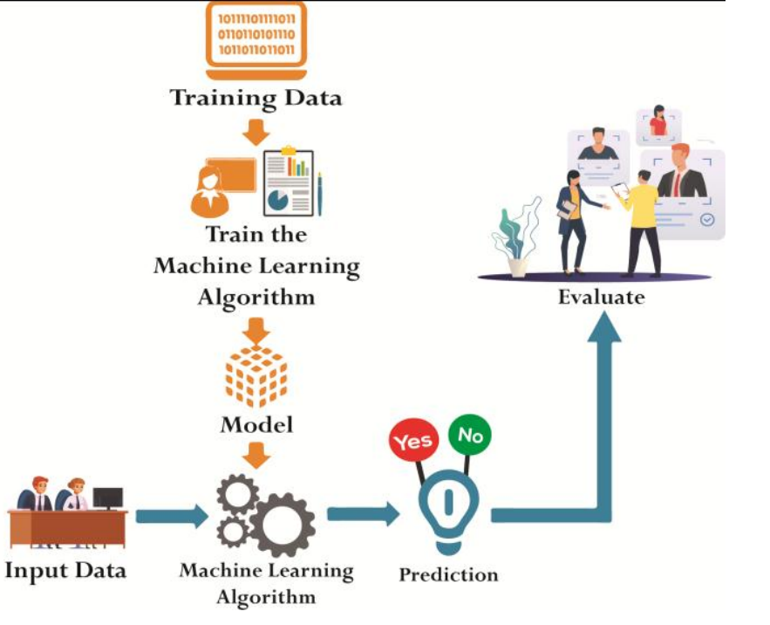
ARCHITECTURE DIAGRAM
Confidential © 2022 Persistent Systems

Slide 8
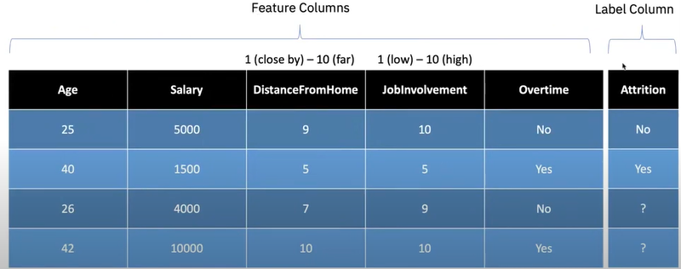
ANALYTICS APPROACH & WORKFLOW
Notebook Links:
EDA-Colab-Notebook
How to predict the Attrition?
Python-Notebook
Confidential © 2022 Persistent Systems

Slide 9
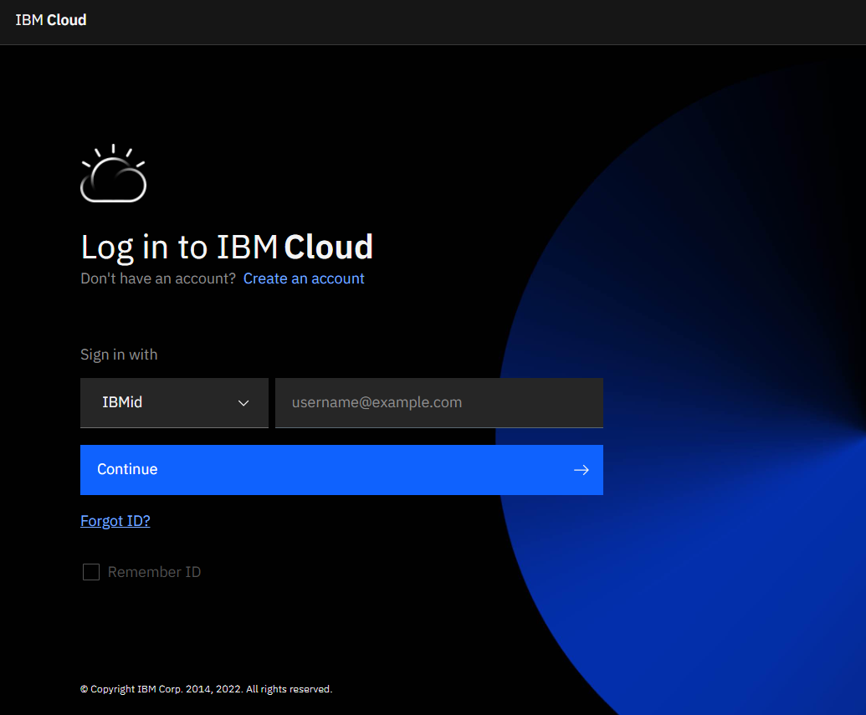

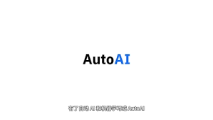

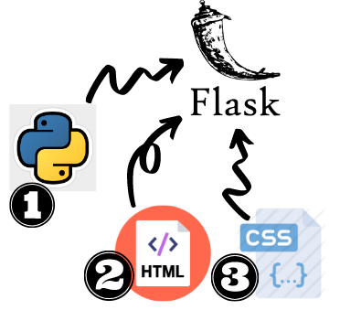

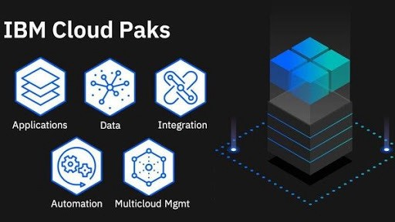
TECHNOLOGIES USED
Confidential © 2022 Persistent Systems

Slide 10

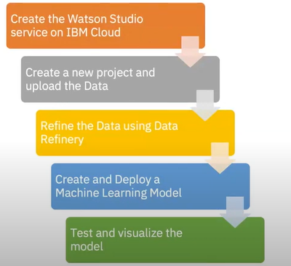
Demo
Workflow of HR Attrition Prediction Using IBM Watson Studio and IBM’s AutoAI Service
\ Random Forest Classifier Model – 85.9% Accuracy
\ Dataset reference: HR-Attrition-Prediction-IBM-Dataset
Model_Deployment_Link
Confidential © 2022 Persistent Systems

Slide 11
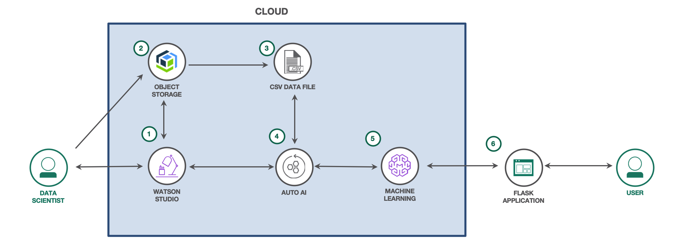
WORKFLOW
Workflow of HR Attrition Prediction Using IBM Watson Studio and IBM’s AutoAI Service
Confidential © 2022 Persistent Systems

Slide 12
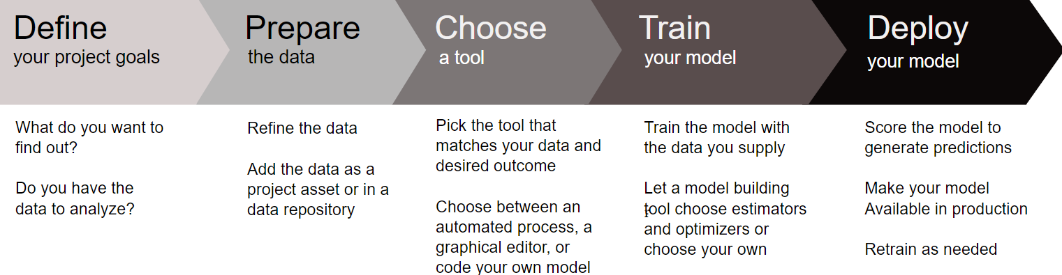
Confidential © 2022 Persistent Systems

Slide 13
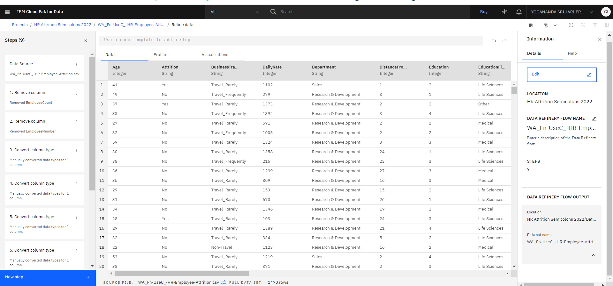
PREDICTION AND RESULT
Confidential © 2022 Persistent Systems

Slide 14
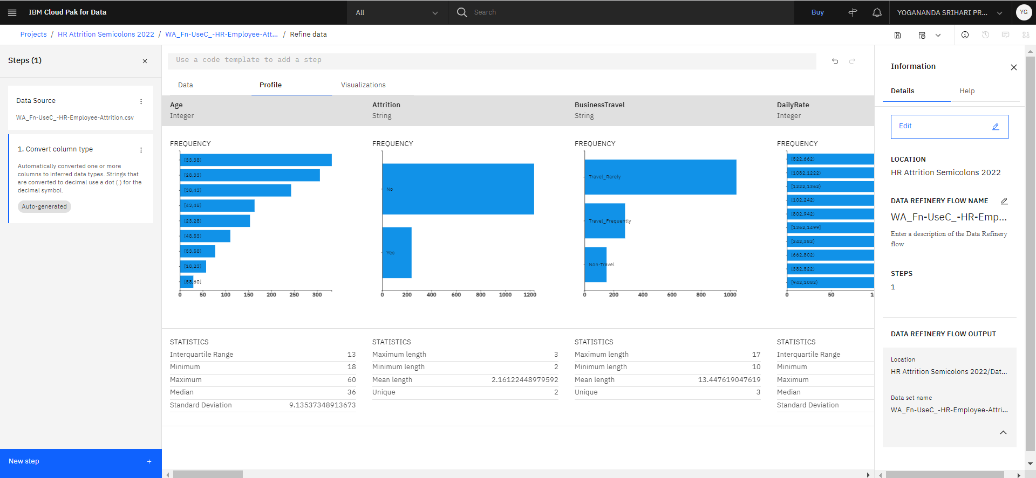
PREDICTION AND RESULT
Confidential © 2022 Persistent Systems

Slide 15
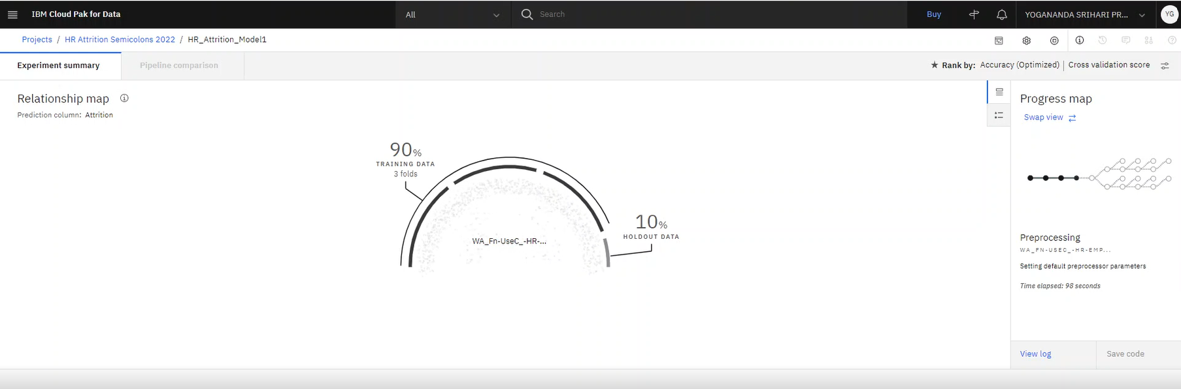
PREDICTION AND RESULT
Confidential © 2022 Persistent Systems

Slide 16
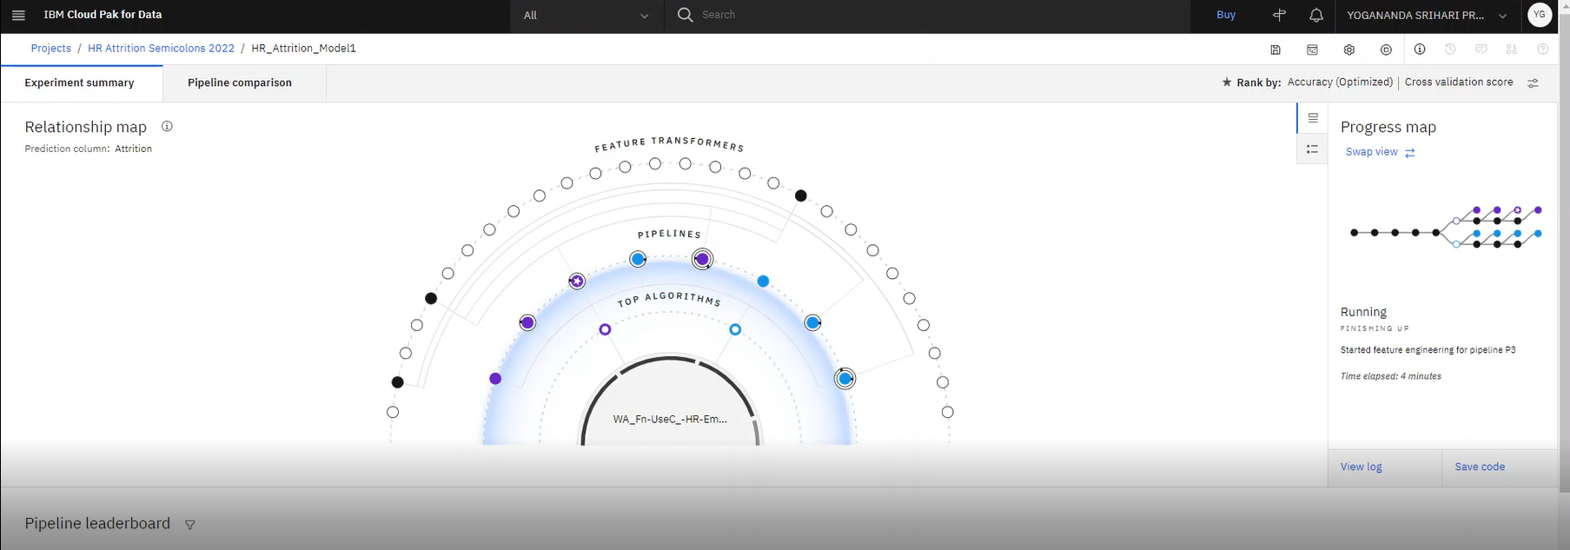
PREDICTION AND RESULT
Confidential © 2022 Persistent Systems

Slide 17
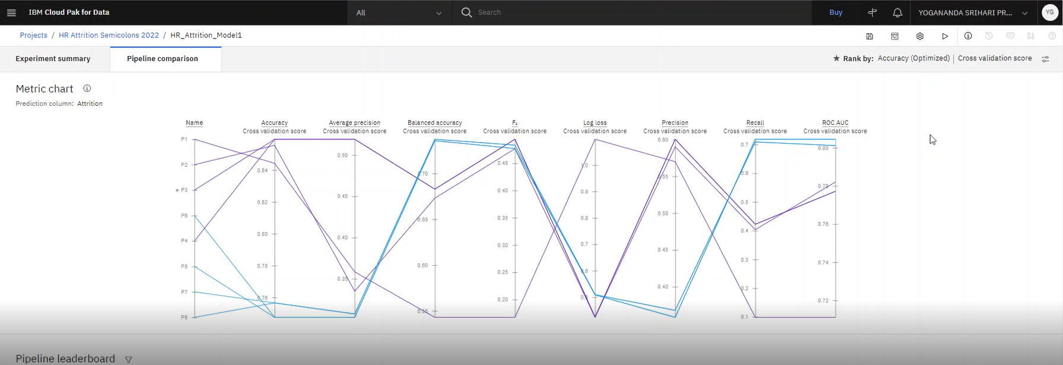
PREDICTION AND RESULT
Confidential © 2022 Persistent Systems

Slide 18
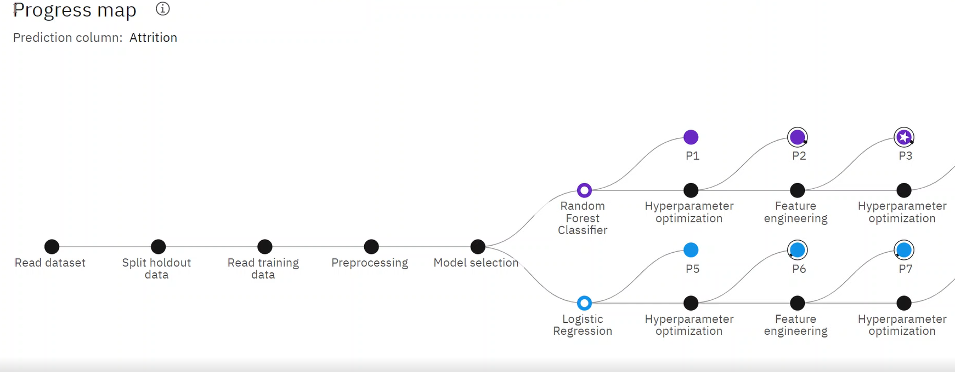
PREDICTION AND RESULT
Confidential © 2022 Persistent Systems

Slide 19
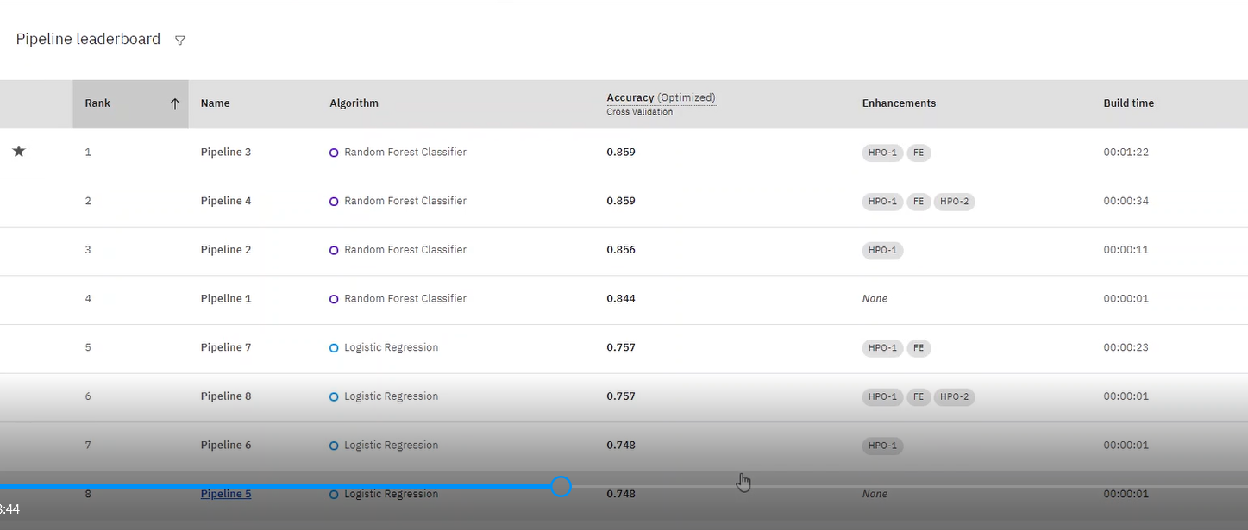
PREDICTION AND RESULT
Confidential © 2022 Persistent Systems

Slide 20
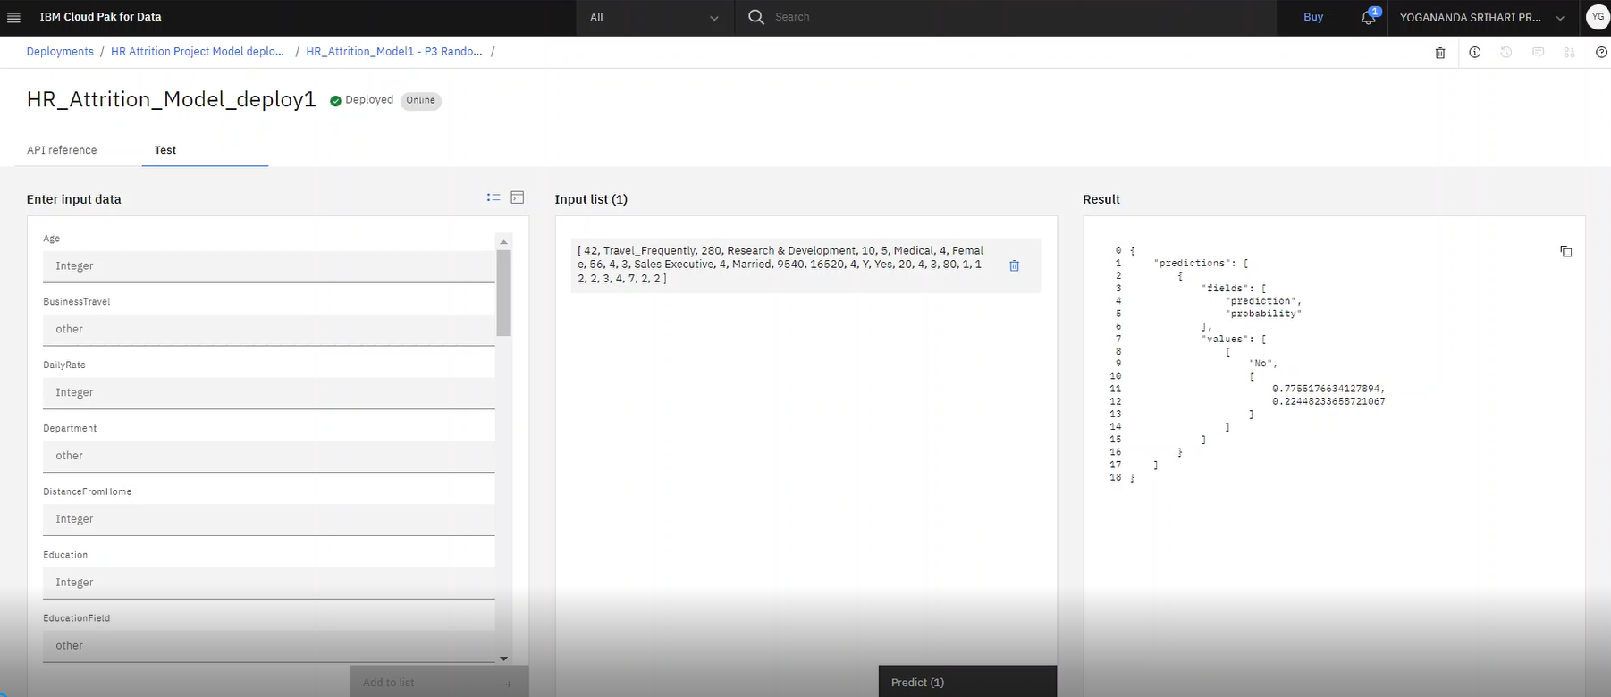
PREDICTION AND RESULT
Confidential © 2022 Persistent Systems

Slide 21
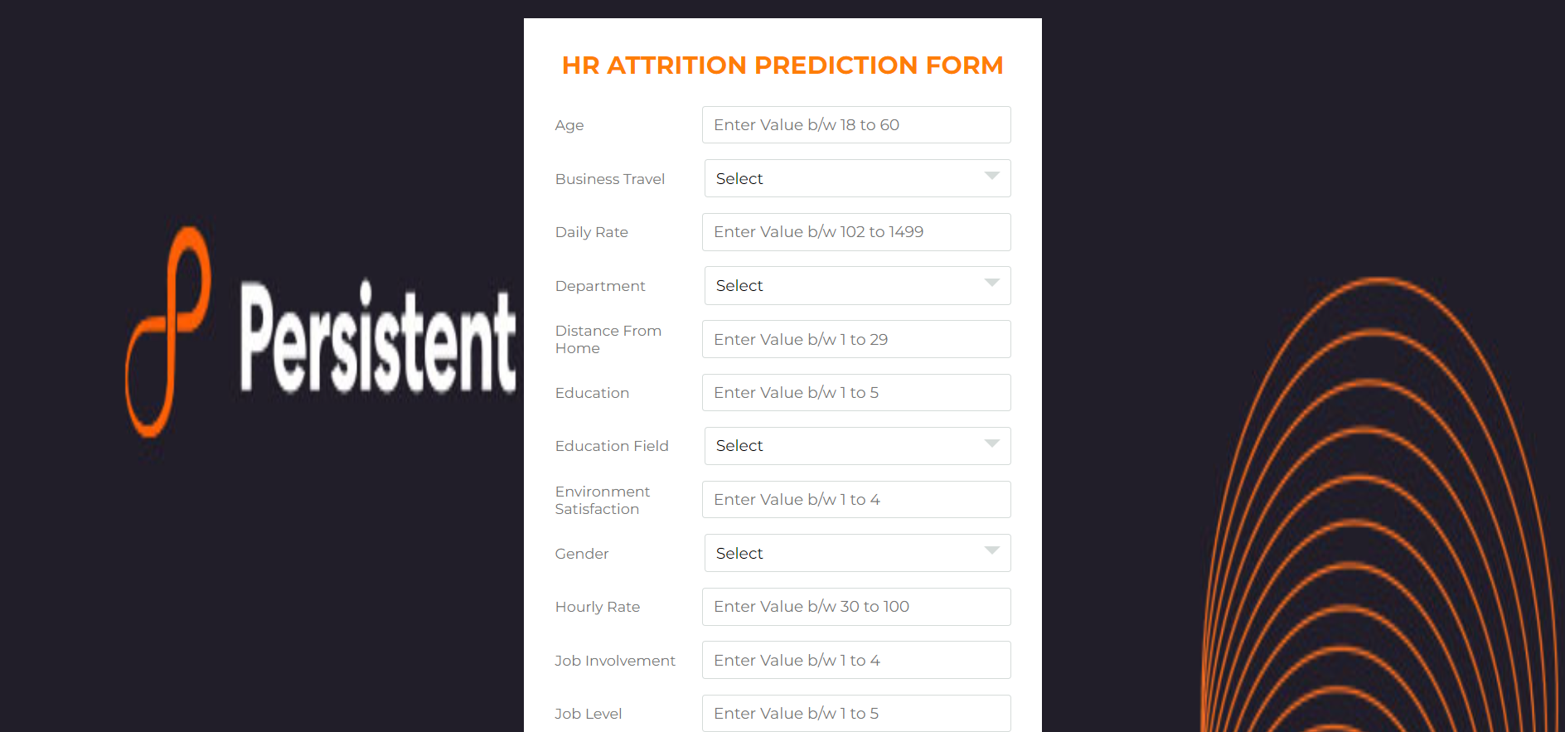
INTEGRATION
Confidential © 2022 Persistent Systems

Slide 22
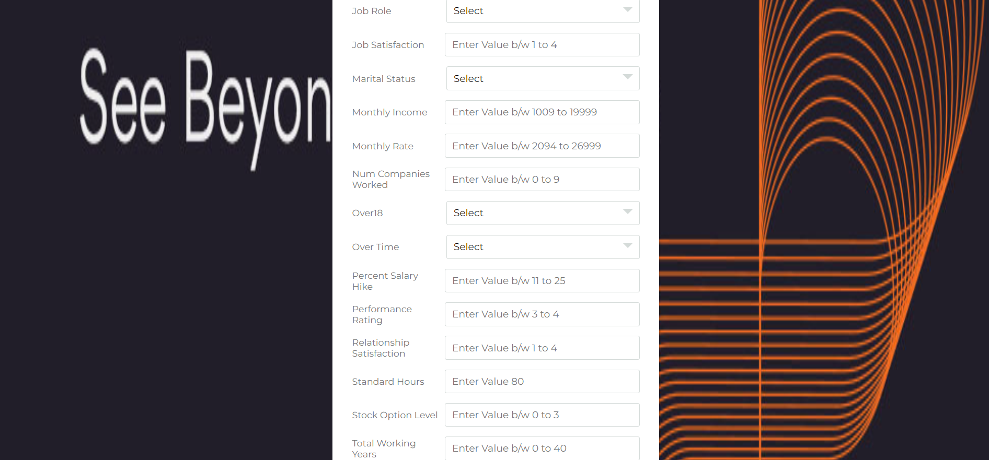
INTEGRATION
Confidential © 2022 Persistent Systems

Slide 23
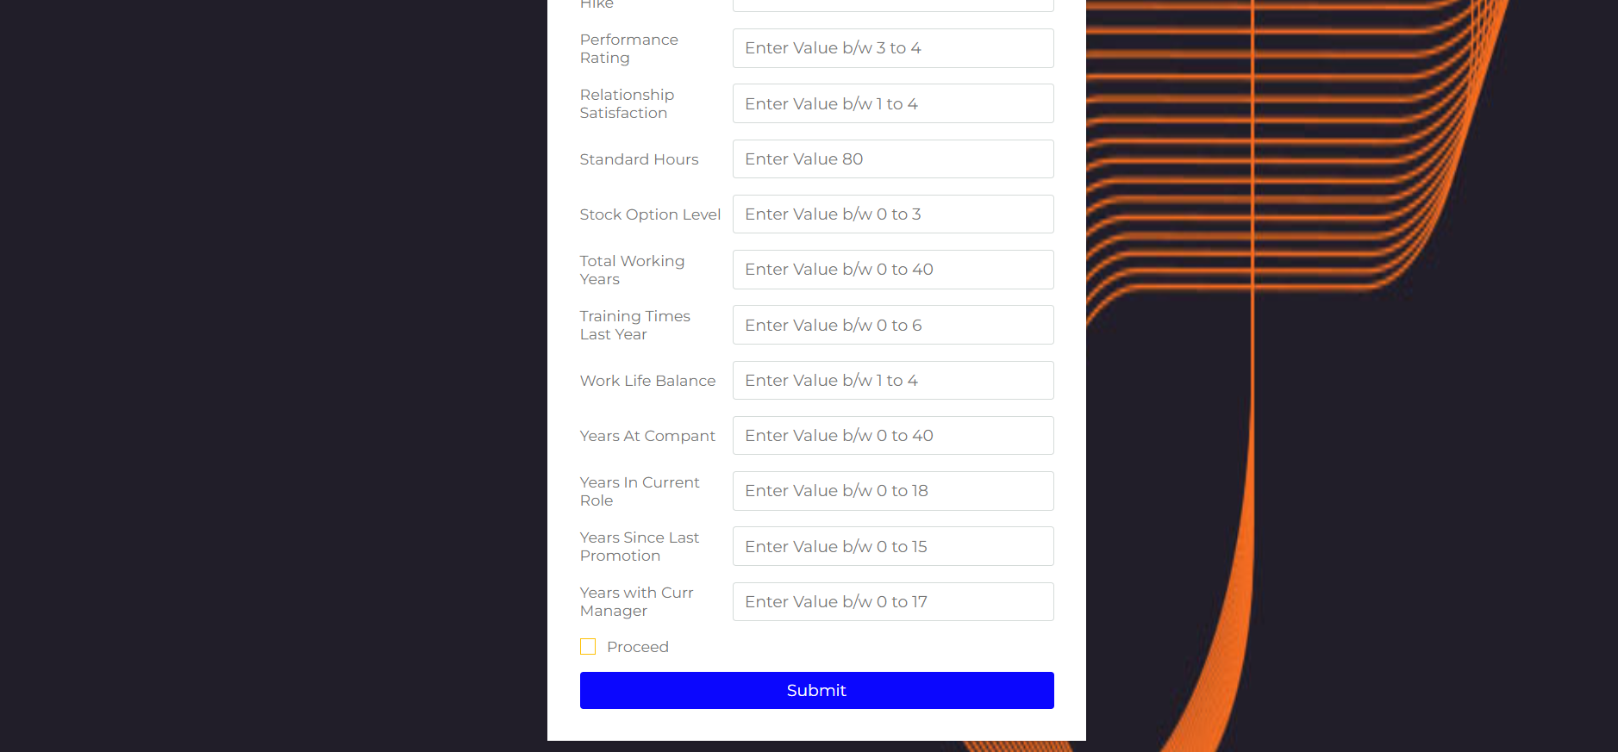
INTEGRATION
Confidential © 2022 Persistent Systems

Slide 24
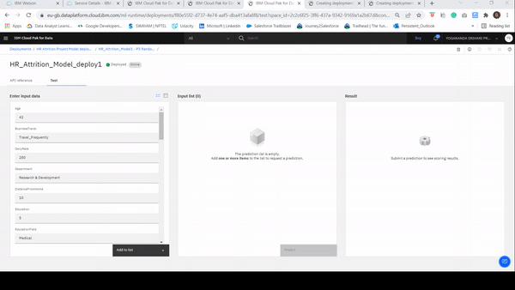
PREDICTION AND RESULT
Confidential © 2022 Persistent Systems

Slide 25
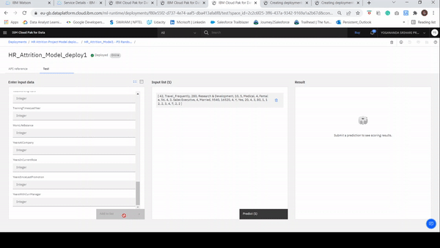
PREDICTION AND RESULT
Confidential © 2022 Persistent Systems

Slide 26
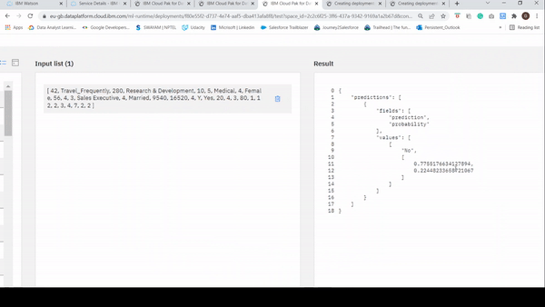
PREDICTION AND RESULT
Confidential © 2022 Persistent Systems

Slide 27
PREDICTION AND RESULT
Confidential © 2022 Persistent Systems

Slide 28
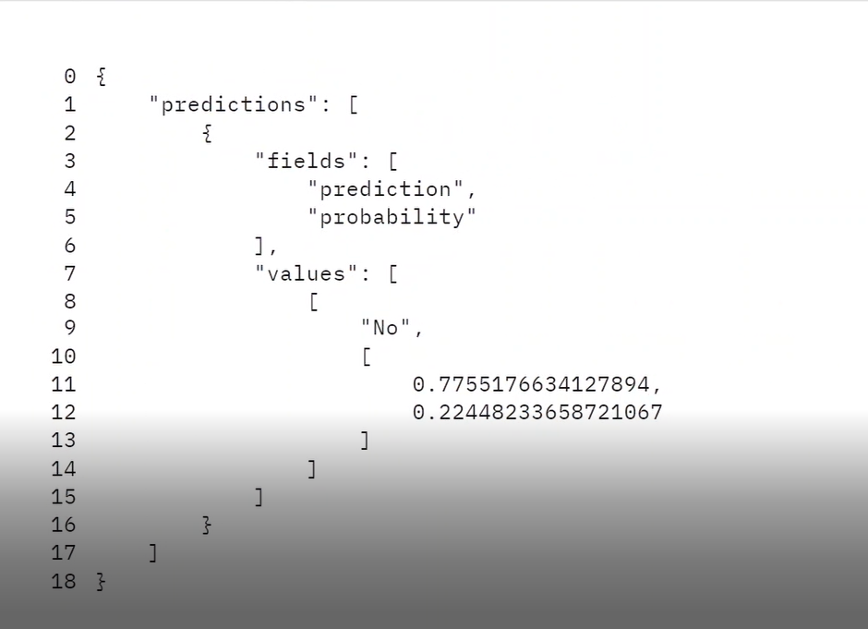
PREDICTION AND RESULT
Model_Deployment_Link
Confidential © 2022 Persistent Systems

Slide 29

Live & Dynamic Dashboard
FUTURE UPDATIONS
Automation using MS Excel Power Query
Automation Using MS Excel would be implemented, where we could get the results when we provide the data in the same format.
Dynamic dashboards built using Tableau, Power BI, Advanced MS Excel and other visualization tools, BI tools by integrating those dashboards to our web application.
Chatbot Integration
We could also integrate a chatbot to our website.
Website Assistant for instant visualizations
Like Alexa, Google Assistant, Better assistance for the Visualizations in our website could be built and by just typing whatever we require, we could obtain the results instantly.
Confidential © 2020 Persistent Systems

Slide 30
Easy-to-use Application
ADDITIONAL BENEFITS
Innovative Solution
A unique solution using latest technologies which allows IBM Watson Studio for training of ML models over sensitive data. Indirectly, the platform enhances access to insights from massive, heterogeneous data.
A platform that can be used by various persona’s such as Product Managers, HR Managers. The UI is easy for navigation, detailing critical information on each steps required for analysis
Business Value
A first-in-market solution in an upcoming and niche field of HR Analytics will make Persistent a flag bearer . Easy-to-scale framework that has brought cutting-edge technologies. By delivering workshops, POC and implementation, we project revenues of $ 4 M USD over a period of next 2 years.
Take-it-to-customer Demo
A working prototype which can be taken to the customer predicting HR Attrition using simple UI interface, And it also helps them to dynamically visualize with the help of amazing interactive dashboards. Also, it will help automating some tasks when we provide the next year data in the same format our automation tool.
Confidential © 2020 Persistent Systems

Slide 31
BUSINESS VALUE & FUNCTIONALITIES
This model will add on to the business and overall organization working culture as it provides a real time data visibility of an employee to the HR representatives.
IBM Watson can become a game changer as it provides the most near absolute prediction of attrition of the employee based on the add on it provides .
Our solution will provide a more optimistic if we get access of the external information of the employee as well.
Functionalities
To predict the attrition for the future months.
Reduce the costly departures
Attrition percentage in respective months.
Helps to control the attrition rates.
Confidential © 2022 Persistent Systems

Slide 32
RESEARCH
https://www.persistent.com/media/press-releases/q3-fy22-results/
http://www.ijaema.com/gallery/23-december-2932.pdf
https://www.aihr.com/blog/what-is-hr-analytics
Confidential © 2020 Persistent Systems

Slide 33
User Experience
Q & A
Business Value
Ease of use, adaptability, maintainability and scalability
Customer Satisfaction
Integrity and Honesty
A Will to Win
A platform that can be used by various persona’s such as, Product Managers, HR Managers, of any organization. The UI is very simple and which is aligned to customer journey. An instant attrition prediction.
Technology & Innovation
Cutting Edge Technology
Machine Learning
IBM Watson, AutoAI, IBM Cloud Pak
User Friendly Dashboard
Execution
Built a model for better classification of dataset.
Built a user form to add attributes, and predict results.
Integrate our ML model to a Web Application.
Built an insight based web dashboard for the HR desk, and integrate it with our Web Application
Confidential © 2020 Persistent Systems

Slide 34
Thank You
Sairaj Dixit Yogananda Gone Nikshita Burde
Abhijit Joshi Avdhut Kulkarni
Confidential © 2022 Persistent Systems

